Slide 1

MAIRA-2: Grounded Radiology Report Generation
Jingyi He
18.Juni.2025
Bannur, S., Bouzid, K., Castro, D. C., Schwaighofer, A., Thieme, A., Bond-Taylor, S., ... & Hyland, S. L. (2024). Maira-2: Grounded radiology report generation. arXiv preprint arXiv:2406.04449.

Slide 2

Introduction: Radiology Reporting
Problem:
labor-intensive and error-prone
Radiologist shortage
2023: Approximately 745,000 patients in England waited over 4 weeks

Slide 3
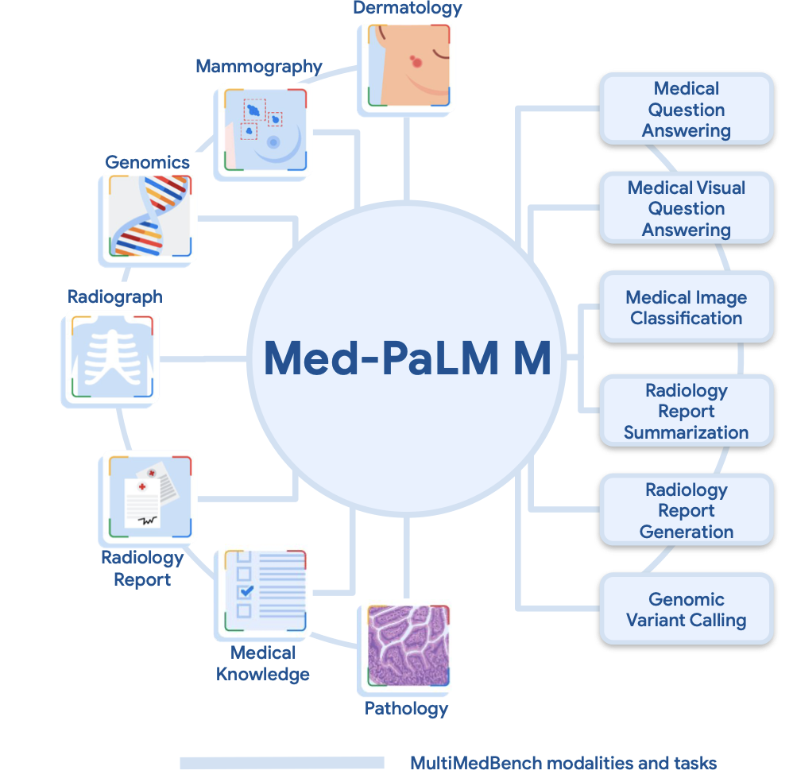
Related Work
Med-PaLM M
Large generalist biomedical model (84B)
Zero-shot capabilities across various datasets
Radiologist-preferred reports in ~40% of cases
but: Very large and not domain-specific
LLaVA-Rad
Radiology-focused model (≈7B), derived from LLaVA
Specialized in chest X-ray report generation
Generalizes well across datasets (MIMIC-CXR, CheXpert, etc.)
Notes:
Other models: Med-PalM, LlaVA-Rad, Med Versa, Maira-1

Slide 4
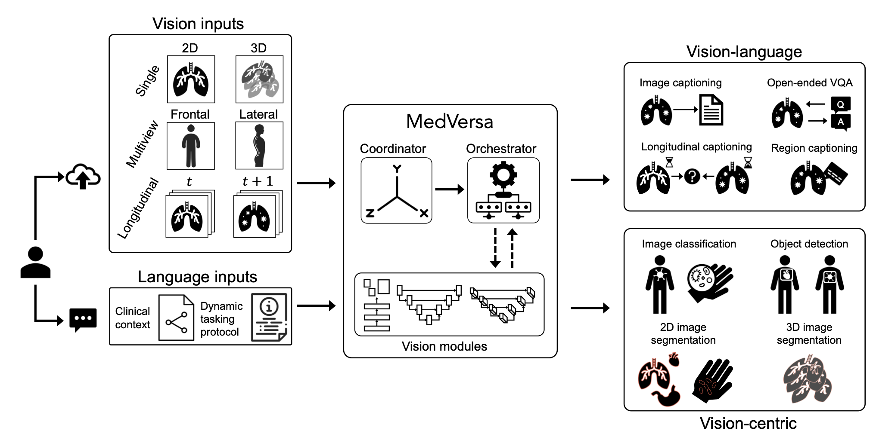
Related Work
MedVersa
General-purpose medical image model with LLM controller
Handles 11 tasks, 13M+ samples
Strength: flexible task handling, dynamic orchestration
but: Less focus on radiology report generation
Notes:
Other models: Med-PalM, LlaVA-Rad, Med Versa, Maira-1

Slide 5
Related Work
Med-PaLM M
Large generalist biomedical model (12B–562B parameters)
Zero-shot capabilities across various datasets
Radiologist-preferred reports in ~40% of cases
but: Very large and not domain-specific
LLaVA-Rad
Radiology-focused model (≈7B), derived from LLaVA
Specialized in chest X-ray report generation
Generalizes well across datasets (MIMIC-CXR, CheXpert, etc.)
MedVersa
General-purpose medical image model with LLM controller
Handles 11 tasks, 13M+ samples
Achieves SOTA on 9/11 tasks
Strength: flexible task handling, dynamic orchestration
but: Less focus on radiology report generation
Maira-1
Radiology-specific vision-language model (7B)
Uses RAD-DINO encoder and deep MLP adapter
Augments training data with GPT-3.5
Strong on CT/CXR report generation
Notes:
Other models: Med-PalM, LlaVA-Rad, Med Versa, Maira-1

Slide 6
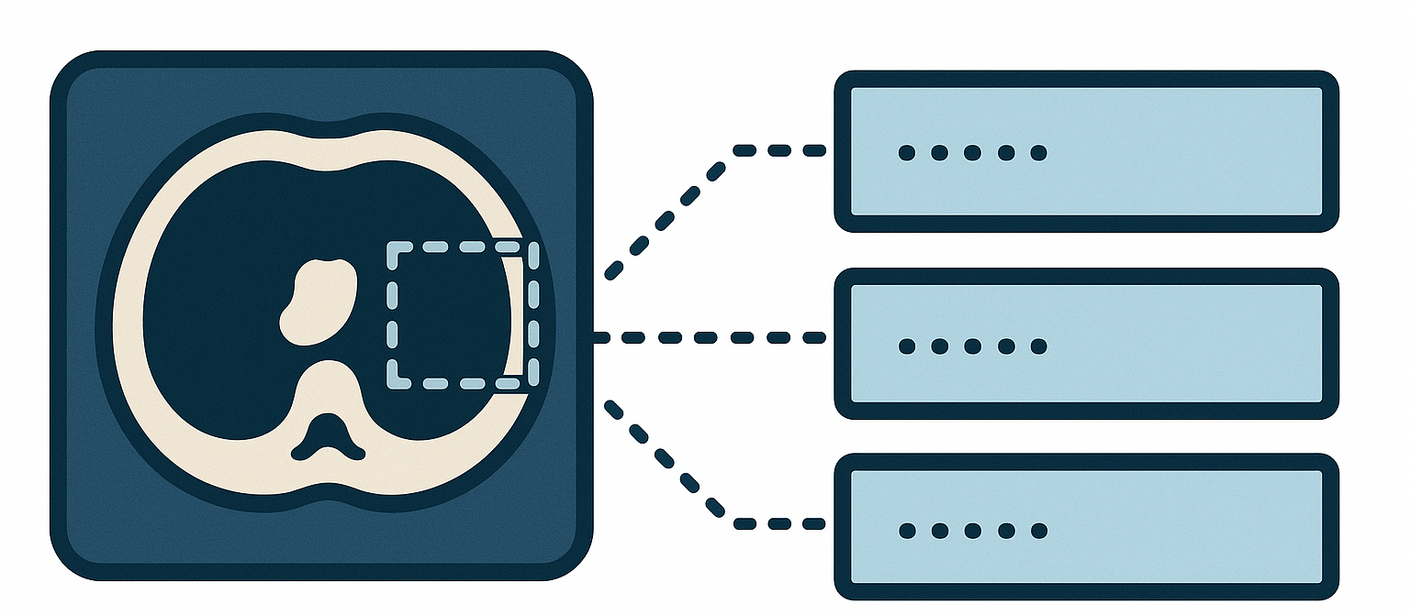
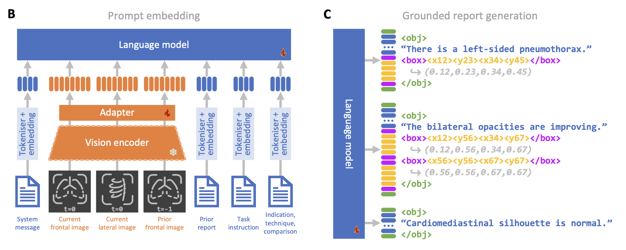
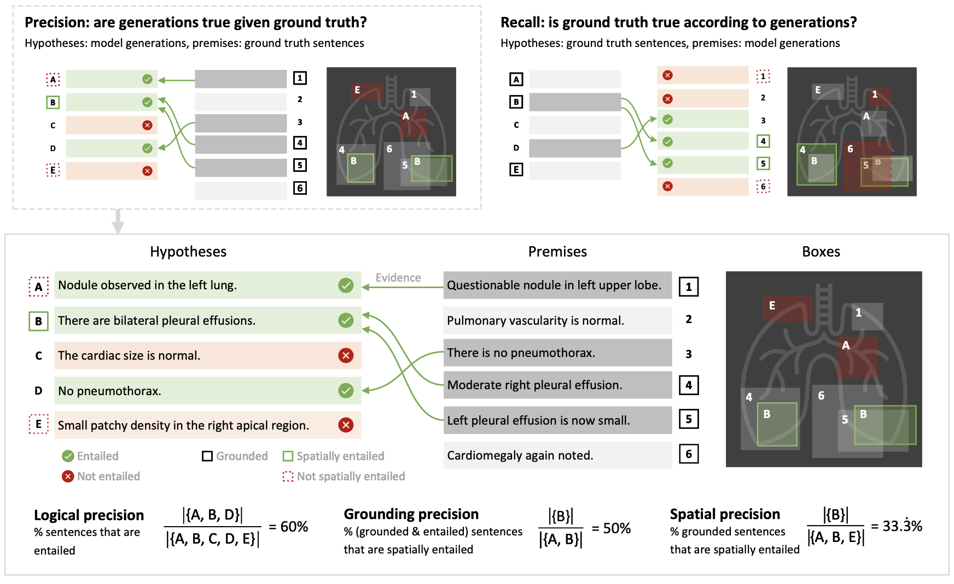
Novel Contribution
Task: Grounded radiology report
Generation for enhanced factual accuracy
Evaluation: RadFact
measures factual consistency with imaging evidence
Model: MAIRA-2
a multimodal architecture tailored for clinical grounding

Slide 7
Grounded Report Generation
Definition
a list of sentences from the Findings section
each describing at most a single observation from the image(s)
associated spatial annotations indicating the location of observation

Slide 8
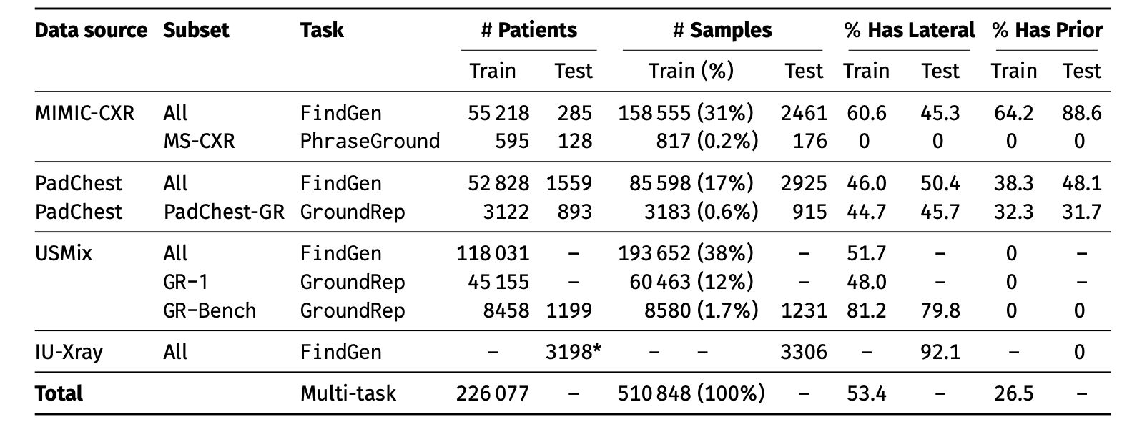
Dataset Statistics
IU-Xray as the fully held out external evaluation set
Additionally annotated on USMix to enable grounded report generation
Tasks include: Finding generation, Phrase grounding, Grounded report generation
Notes:
Need to mention how they get the Ground Rep part, from: extraction using GPT-4, annotation by experts

Slide 9
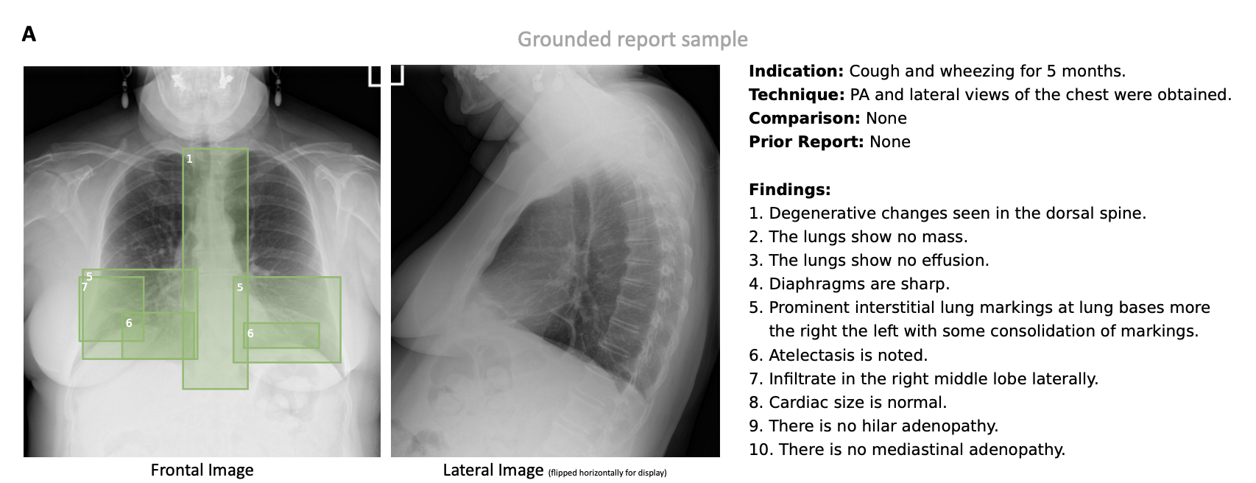
Dataset Preprocessing
Notes:
Exmaple for ground report, explain each part The Indication provides clinical context on the patient and influences interpretation and
reporting. The Technique describes acquired views and sometimes patient positioning (e.g. supine, lateral), while
Comparison indicates whether the radiologist consulted prior studies.

Slide 10
Model Structure: Overview

Slide 11
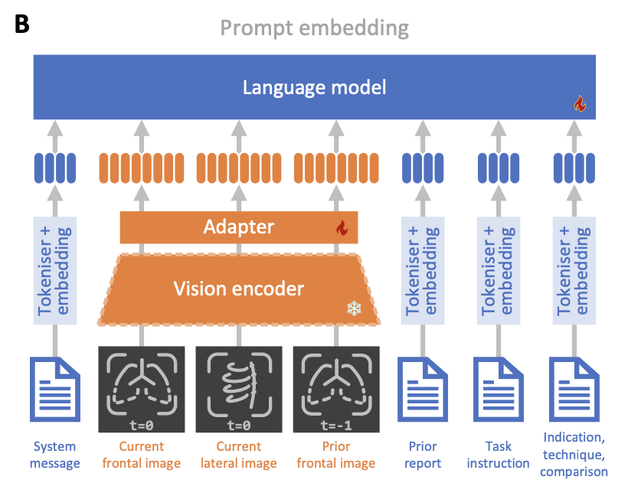
Model Structure: Input
Components
Vision encoder (frozen): RAD-DINO-MAIRA-2, 87M-Parameter ViT-B
Adapter: 4 Layer MLP
LLM: Vicuna 7B v1.5
ingests interleaved text and images, images are patched into sizes of 14x14

Slide 12
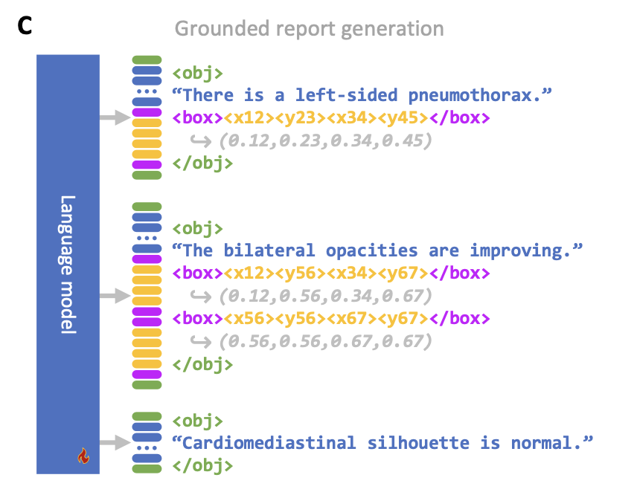
Model Structure: Output
Box format: <box> x1 y1 x2 y2 </box> (top-left to bottom-right)
Text mentions: <obj> object name </obj>
Grid size: 100×100 coordinates normalized to this grid
Token sets: Top-left and bottom-right use disjoint vocabularies (N + N tokens)
allow several boxes for one finding

Slide 13
Evaluation Metric: RadFact
Notes:
explain the intuition behind: use Llama3-70B-Instruct todecide if entailed, since lexical (NLG) metrics not enough
and does not rely on pre-
specified error categories or radiology-specialised models.
relies on the logical inference capabilities of LLMs20,52 to directly evaluate the correctness and
completeness of generated reports
for entailment verification with ten
in-context examples

Slide 14
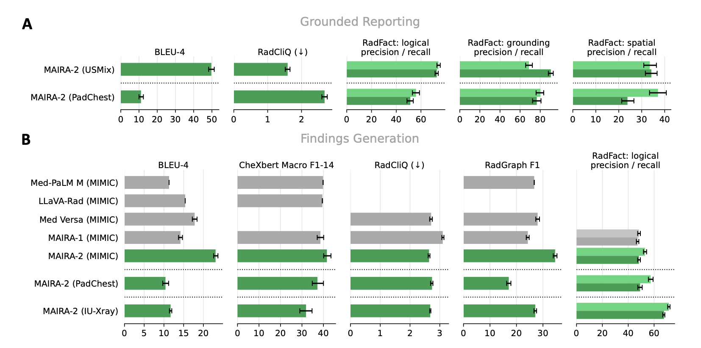
Results: Lexical Scores

Slide 15
Results: RadFact Scores
Notes:
Panal a: compare USMix and PadChest, lexical. Logical: Padchest lack indication section; but more balanced in grounding; bur the spatial for each is low
Panal B: traditinal finding generation: lexical significant, other clinical good resuolts
for padchest iuxray: additinally repoting style different –Radgraph may not be reliable
generalizing good: IU X-ray

Slide 16
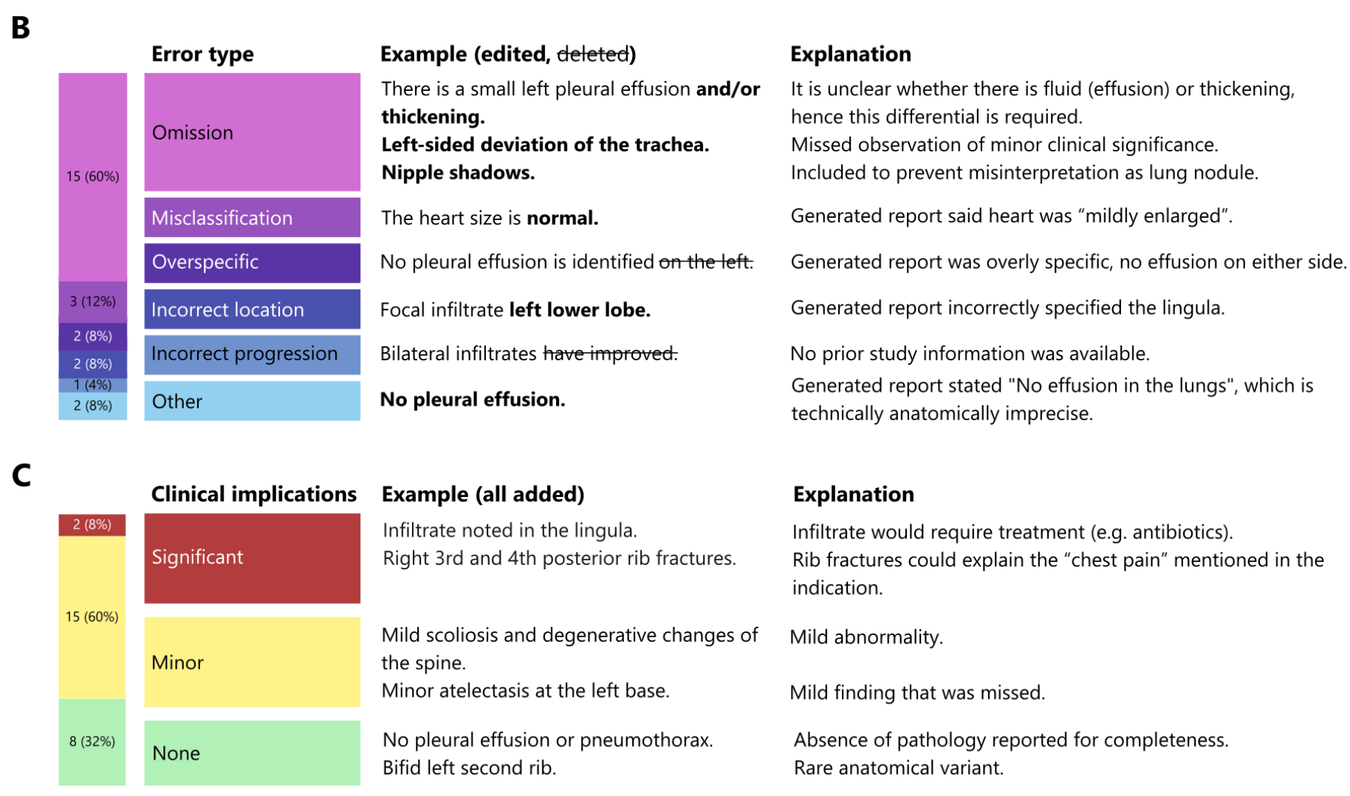
Results: Qualatative
Notes:
14/20 reports (70%)
required fewer than two corrections, and 123/135 gener-
ated sentences (91%) were acceptable as-is.
omis-
sions being the most common error category
‘clinical implications’ of most
errors were minor to none
‘acceptable
as a draft’, alike ‘the performance of a junior-to-mid level
resident’ that needs to receive additional human expert
review before signing-off on any one report.

Slide 17
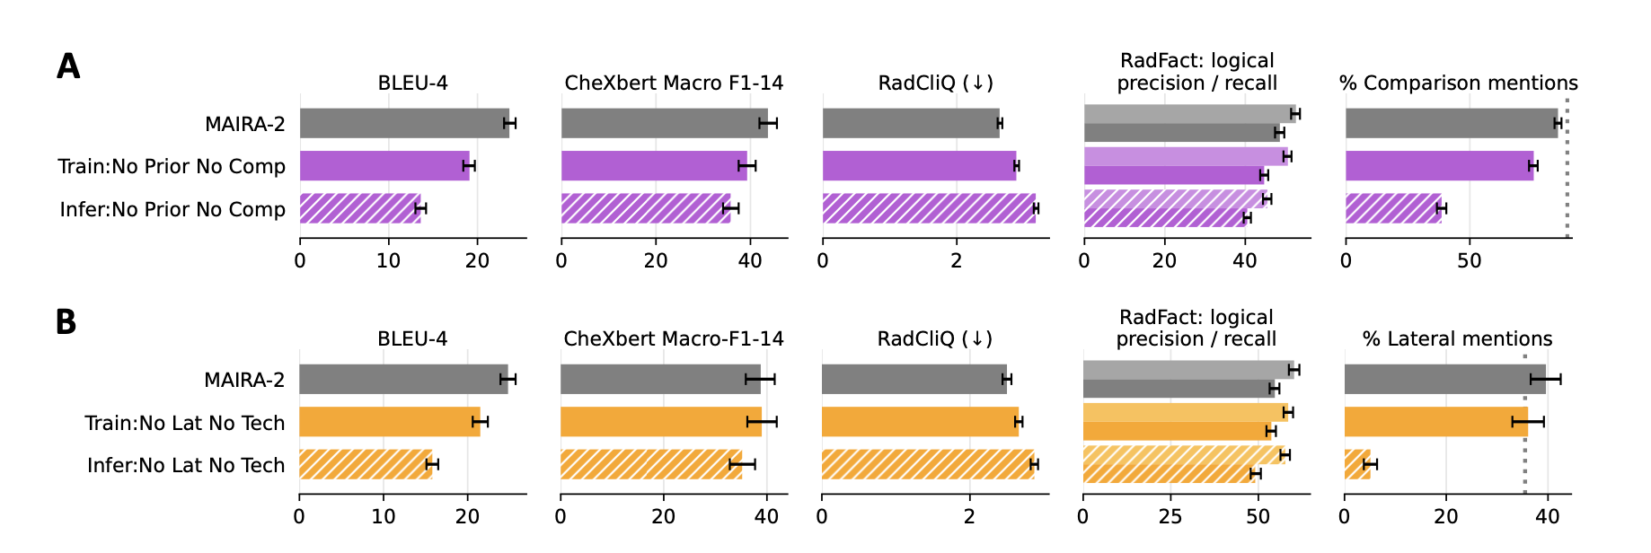
Results: Abolation on MIMIC-CXR
Two types: training time ablation & test time ablation
Aspects: temporal hallucination, spurious lateral mentions

Slide 18
Discussions
Missed findings are the most frequent error; improving recall is critical.
RadFact directly targets the core goal: identifying diagnostic errors.
Limitation of RadFact:
Clinical significance of errors is not fully captured.
Process only one sentence at a time, might be unable to capture inconsistency in the report
Limitation of Maira-2:
Existing grounded datasets lack complete input modalities.
The model may underutilize additional imaging, relying on shortcuts.

Slide 19
Reference
UK HSA. Medical imaging: What you need to know. 2022.
*URL:* [https://www.gov.uk/government/publications/medical-imaging-what-you-need-to-know/medical-imaging-what-you-need-to-know--2](https://www.gov.uk/government/publications/medical-imaging-what-you-need-to-know/medical-imaging-what-you-need-to-know--2)
2. Fischetti C, Bhatter P, Frisch E, et al. The evolving importance of artificial intelligence and radiology in medical trainee education. *Academic Radiology* 2022;29\:S70–S75.
3. Kalidindi S and Gandhi S. Workforce Crisis in Radiology in the UK and the Strategies to Deal With It: Is Artificial Intelligence the Saviour? *Cureus* 2023;15\:e43866.
4. RCR. Clinical Radiology Workforce Census 2022. The Royal College of Radiologists 2022.
5. Rimmer A. Radiologist shortage leaves patient care at risk, warns royal college. *BMJ: British Medical Journal (Online)* 2017;359.
6. Huang J, Neill L, Wittbrodt M, et al. Generative Artificial Intelligence for Chest Radiograph Interpretation in the Emergency Department. *JAMA Network Open* 2023;6\:e2336100–e2336100.
7. Liu G, Hsu TMH, McDermott M, et al. Clinically accurate chest x-ray report generation. In: *Machine Learning for Healthcare Conference*. PMLR. 2019:249–69.
8. Yildirim N, Richardson H, Wetscherek MT, et al. Multimodal Healthcare AI: Identifying and Designing Clinically Relevant Vision-Language Applications for Radiology. *arXiv preprint* arXiv:2402.14252 (2024).
9. Yu F, Endo M, Krishnan R, et al. Evaluating progress in automatic chest x-ray radiology report generation. *Patterns* 2023;4:100802.
10. Zhou HY, Adithan S, Acosta JN, Topol EJ, and Rajpurkar P. A Generalist Learner for Multifaceted Medical Image Interpretation. *arXiv preprint* arXiv:2405.07988 (2024).
11. Yang L, Xu S, Sellergren A, et al. Advancing Multimodal Medical Capabilities of Gemini. *arXiv preprint* arXiv:2405.03162 (2024).
12. Tu T, Azizi S, Driess D, et al. Towards Generalist Biomedical AI. *NEJM AI* 2024;1\:Aloa2300138.
13. Chen Z, Varma M, Delbrouck JB, et al. CheXagent: Towards a Foundation Model for Chest X-Ray Interpretation. *arXiv preprint* arXiv:2401.12208 (2024).
14. Wang Z, Liu L, Wang L, and Zhou L. Metransformer: Radiology report generation by transformer with multiple learnable expert tokens. In: *Proceedings of the IEEE/CVF Conference on Computer Vision and Pattern Recognition*. 2023:11558–67.
15. Li M, Lin B, Chen Z, Lin H, Liang X, and Chang X. Dynamic graph enhanced contrastive learning for chest x-ray report generation. In: *Proceedings of the IEEE/CVF Conference on Computer Vision and Pattern Recognition*. 2023:3334–43.
16. Nguyen D, Chen C, He H, and Tan C. Pragmatic Radiology Report Generation. In: *Machine Learning for Health (ML4H)*. PMLR. 2023:385–402.
17. Bannur S, Hyland S, Liu Q, et al. Learning to exploit temporal structure for biomedical vision-language processing. In: *Proceedings of the IEEE/CVF Conference on Computer Vision and Pattern Recognition*. 2023:15016–27.
18. Bernstein MH, Atalay MK, Dibble EH, et al. Can incorrect artificial intelligence (AI) results impact radiologists, and if so, what can we do about it? A multi-reader pilot study of lung cancer detection with chest radiography. *European Radiology* 2023;33:8263–9.
19. Moor M, Banerjee O, Abad ZSH, et al. Foundation models for generalist medical artificial intelligence. *Nature* 2023;616:259–65.
20. Min S, Krishna K, Lyu X, et al. FactScore: Fine-grained Atomic Evaluation of Factual Precision in Long Form Text Generation. In: *Proceedings of the 2023 Conference on Empirical Methods in Natural Language Processing*. Singapore: ACL, 2023:12076–100.
DOI: [10.18653/v1/2023.emnlp-main.741](https://doi.org/10.18653/v1/2023.emnlp-main.741)

Slide 20
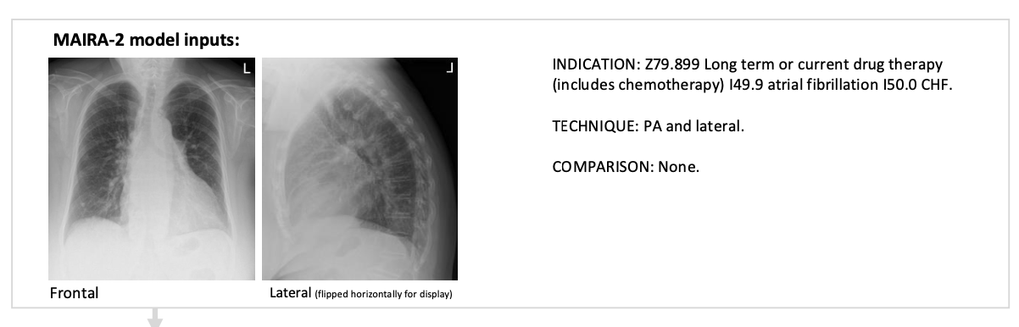
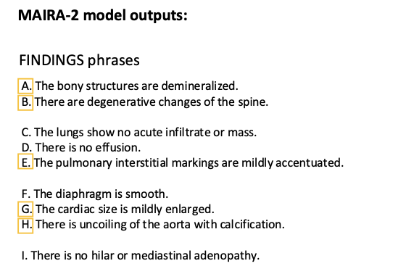
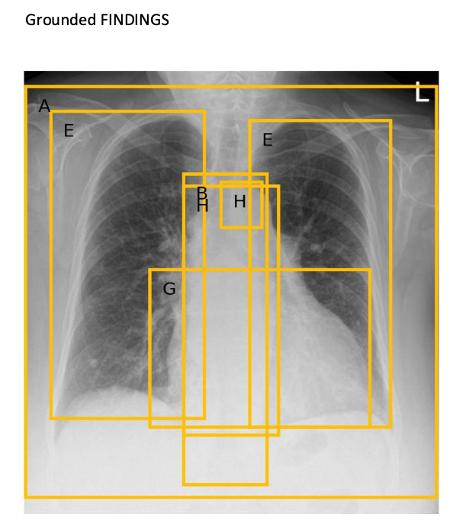
Backup slides

Slide 21
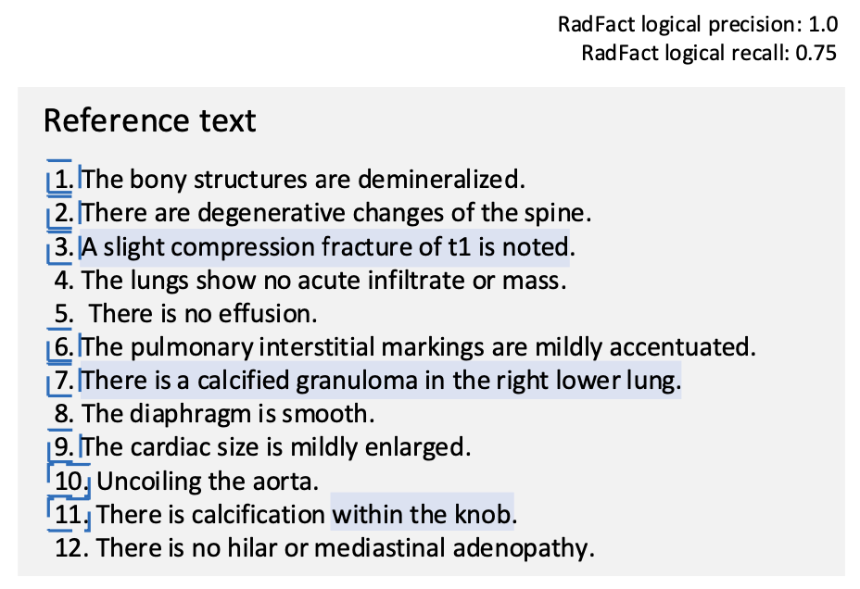
Backup slides

Slide 22
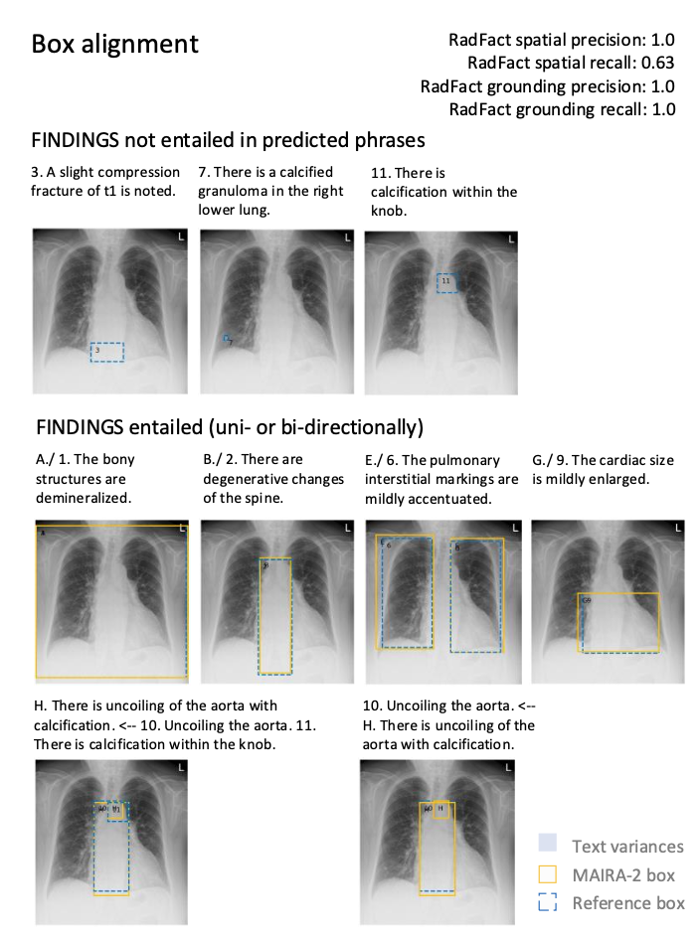
Backup slides

